Slide 2
The Corporal Works of Mercy
Spreading God’s mercy is central to the mission of the Catholic Church. The Church calls on us to reach out to God’s people in body and spirit. When we honor the life and dignity of a fellow person, sharing what we have with another, we are practicing the corporal works of mercy.

Slide 3
The Corporal Works of Mercy
Feed the hungry
Give drink to the thirsty
Clothe the naked
Shelter the homeless
Visit the sick
Visit the imprisoned
Bury the dead

Slide 4
Feed the hungry
Notes:
Feeding the hungry is the first corporal work of mercy mentioned by Jesus: “For I was hungry and you gave me food” (Matthew 25:35). In the Second Vatican Council, the Church looked at our world of surplus and excess and cried out to us as individuals and governments, “Feed the people dying of hunger, because if you do not feed them, you are killing them” (Gaudium et Spes, no. 69). Pope Francis has been similarly direct: “Let us remember well, however, that whenever food is thrown out, it is as if it were stolen from the table of the poor, from the hungry!” (General Audience, June 5, 2013). We are called to both give food to those who are hungry, and to help people find ways to gain regular access to food.

Slide 5
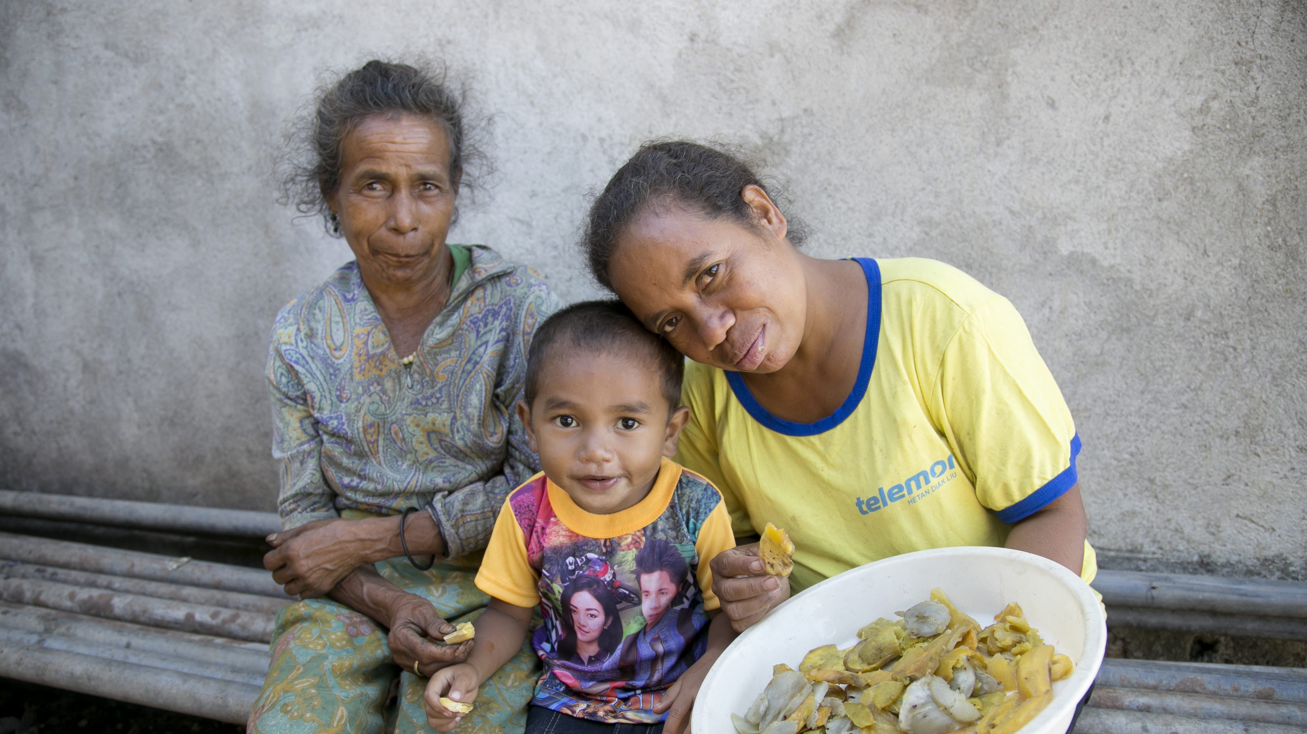
Feed the hungry
Photo by Jennifer Hardy/CRS
Notes:
Many families in Timor-Leste live in rural areas and work as farmers, but challenges like climate change make it difficult to grow enough food. They depend on rice as a main part of their meals, and hunger and malnutrition are big problems—more than one-third of people in Timor-Leste don’t have reliable access to enough nutritious food.
With training from CRS, families are starting home gardens to grow different vegetables, beans and other foods rich in nutrients like vitamin A and iron. The gardens are built to withstand droughts and flooding, and the families add the food they grow—such as spinach, cabbage, peanuts, carrots and tomatoes—to their daily rice staple, providing more nourishing meals that help children grow and their families stay healthy.
As part of the CRS program, parents attend community nutrition groups where they learn how to build and improve their gardens and new recipes to use their fresh produce. Program participants can also choose to raise chickens or start a fishpond which provide additional protein and income.

Slide 6
Give drink to the thirsty
Notes:
Water is life-giving and life-sustaining. As such, the Church recognizes that it is not just another commodity, like copper or rubber. If, indeed, we have a right to life, we have a right to clean, drinkable water. Many of our sisters and brothers in Christ do not have access to clean water, a basic necessity that each person needs to survive. A world where nearly 1 billion people are denied this right is a grave injustice.

Slide 7
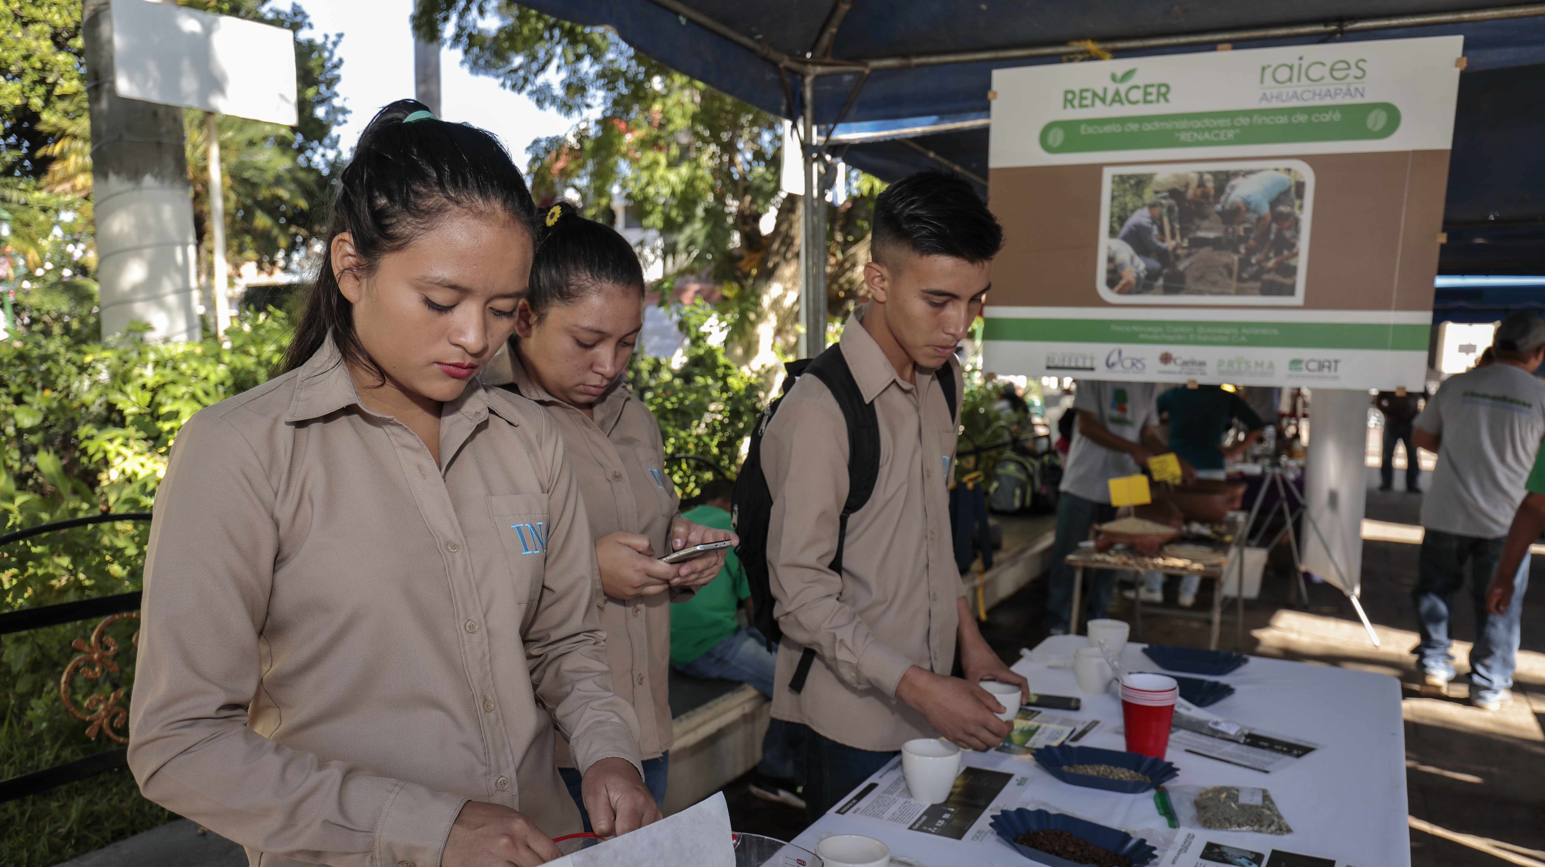
Give drink to the thirsty
Photo by Oscar Leiva/Silverlight for CRS
Notes:
Besides drinking, bathing, cooking and other uses, water is essential for farming. In El Salvador, soil erosion from deforestation and persistent drought due to climate change have made it difficult for farmers to grow their crops. It is one of the most deforested countries in the western hemisphere, and the farmland is so depleted that it cannot retain water and vital nutrients. As a result, roughly 400,000 small farmers are struggling to grow enough food to feed their families and earn a decent living.
At a high school in Ahuachapán, El Salvador, students in the Agriculture Baccalaureate program are learning new farming techniques and technology that will help restore the environment. CRS is partnering with the school program to engage local youth to become the next generation of leaders and land stewards. Through the program, students are learning new skills like the importance of distancing when plowing, how to use water, organic manure and other resources more efficiently to provide nutrients to the soil, and how burning harvest residue can harm the land and air. Through these and other practices, these future farmers will be able to restore the land to its former richness and produce more—and healthier—crops to feed their communities.

Slide 8
Clothe the naked
Notes:
While clothing differs from culture to culture, lack of clean, sanitary clothes can threaten a person’s health and assault their dignity, shaming them and separating them from society. Proper clothing protects a person’s physical body and upholds their human dignity.
“To clothe the naked: what does it mean if not to restore dignity to one who has lost it? Certainly giving clothing to one who has none; but let us also think about the women victims of trafficking, cast onto the streets, or of other many ways of using the human body as a commodity, even that of minors. Likewise, not having a job, a house, a fair wage are forms of nakedness; being discriminated against on account of race, of faith, are all forms of “nakedness”, to which as Christians we are called to be attentive, vigilant and ready to act.” – Pope Francis, General Audience, October 26, 2016

Slide 9
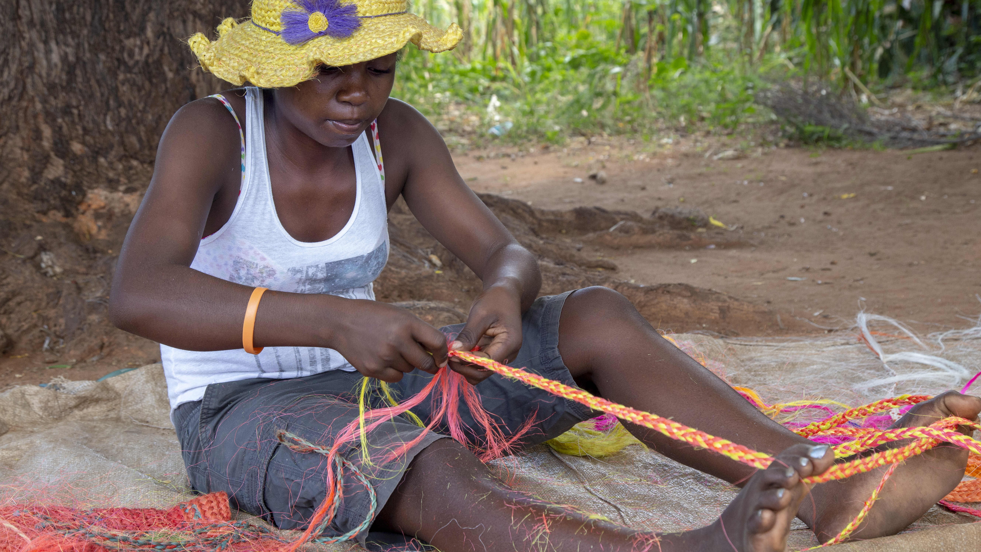
Clothe the naked
Photo by Dooshima Tsee/CRS
Notes:
In the arid lands of Madagascar, farmers weave hats out of plant fibers to sell to travelers. The beautiful hats provide protection from the sun as well as additional income for the farmers and their families so they can purchase enough nutritious food.

Slide 10
Shelter the homeless
(Welcome the stranger)
Notes:
To welcome the stranger is another way of saying to shelter the homeless. There are more displaced people now than ever before—nearly 80 million people. Forced by poverty, violence, persecution and other reasons to flee their homeland, migrants and refugees face dangerous journeys and risk losing everything to find safety and a better future for their families. We are called to support our sisters and brothers on the move and to welcome them into our own communities.
“In our time, charitable action regarding foreigners is more relevant than ever. The economic crisis, armed conflicts and climate change force many people to emigrate. However, migration is not a new phenomenon, it is part of the history of humanity. … Over the course of the centuries we have witnessed, in this regard, great expressions of solidarity, although there has been no lack of social tension. Today, the context of the economic crisis unfortunately fosters the emergence of attitudes of closure and not of welcome. In some parts of the world walls and barriers are going up. … The only way to a solution is that of solidarity. Solidarity with the migrant, solidarity with the foreigner. … We all, dioceses, parishes, institutes of consecrated life, associations and movements, as individual Christians, are called to welcome our brothers and sisters who are fleeing from war, from hunger, from violence and from inhuman living conditions. All together we are a great supportive force for those who have lost their homeland, family, work and dignity.”
Pope Francis, General Audience, October 26, 2016

Slide 11
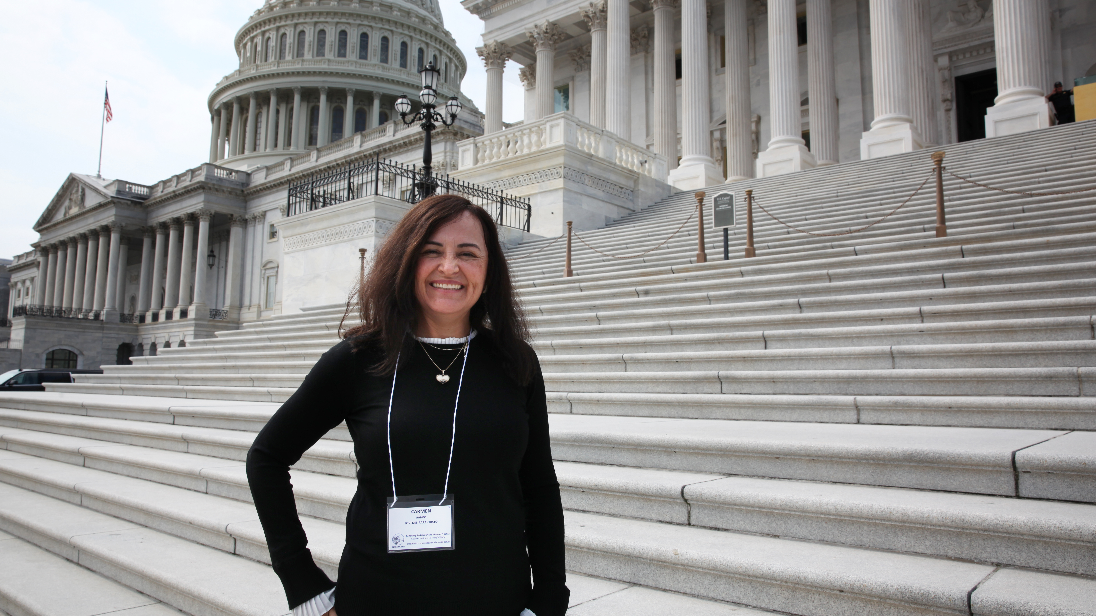
Shelter the homeless (Welcome the stranger)
Photo by Richard Reinhard for CRS
Notes:
As the former president of the lay apostolic organization Asociación Jóvenes Para Cristo/Young Adults for Christ (AJPC), Carmen Ramos is fearless when speaking about her faith, God’s mercy and love, and the call to put our faith into action. So, when she had the opportunity to travel to Washington, DC to take part in the National Catholic Council for Hispanic Ministry’s Advocacy Day, she jumped at the chance. She would be part of a delegation from California meeting with members of Congress and their staff to address the challenges facing migrants and refugees and the need to support them—an issue close to her own heart.
Carmen was able to give her own personal testimony during her meetings with her members of Congress. Although she was nervous, she believed God would use her as a channel to speak for, “the needs of each of my brothers and sisters and those whom I come to advocate for.” Their needs, she explains, “made me speak from the heart.”
Carmen looks to the Blessed Mother as a model, comparing advocacy to intercessions. “Imagine if our Holy Mother, the Virgin Mary, would not advocate or intercede for our requests, what would happen?” she asks. “We must shout and say, ‘Here I am for the one who cannot speak, the one who cannot raise their voice, for the one who is afraid, for the one who is not encouraged.’” Even if we are afraid or think the situation is unchangeable or that no one will listen, we must have faith, she urges.

Slide 12
Visit the sick
Notes:
The pain of the sick and the dying touches us deeply, just as our suffering has touched God deeply, moving him to come among us as a healer. Jesus also suffered for us—and in solidarity with us—because suffering and vulnerability is something that happens and will happen to us all. Our suffering nature similarly calls us all into deepest solidarity with those who are suffering. We are called to visit—or comfort—the sick, to try to alleviate their suffering through our presence, care and support.

Slide 13
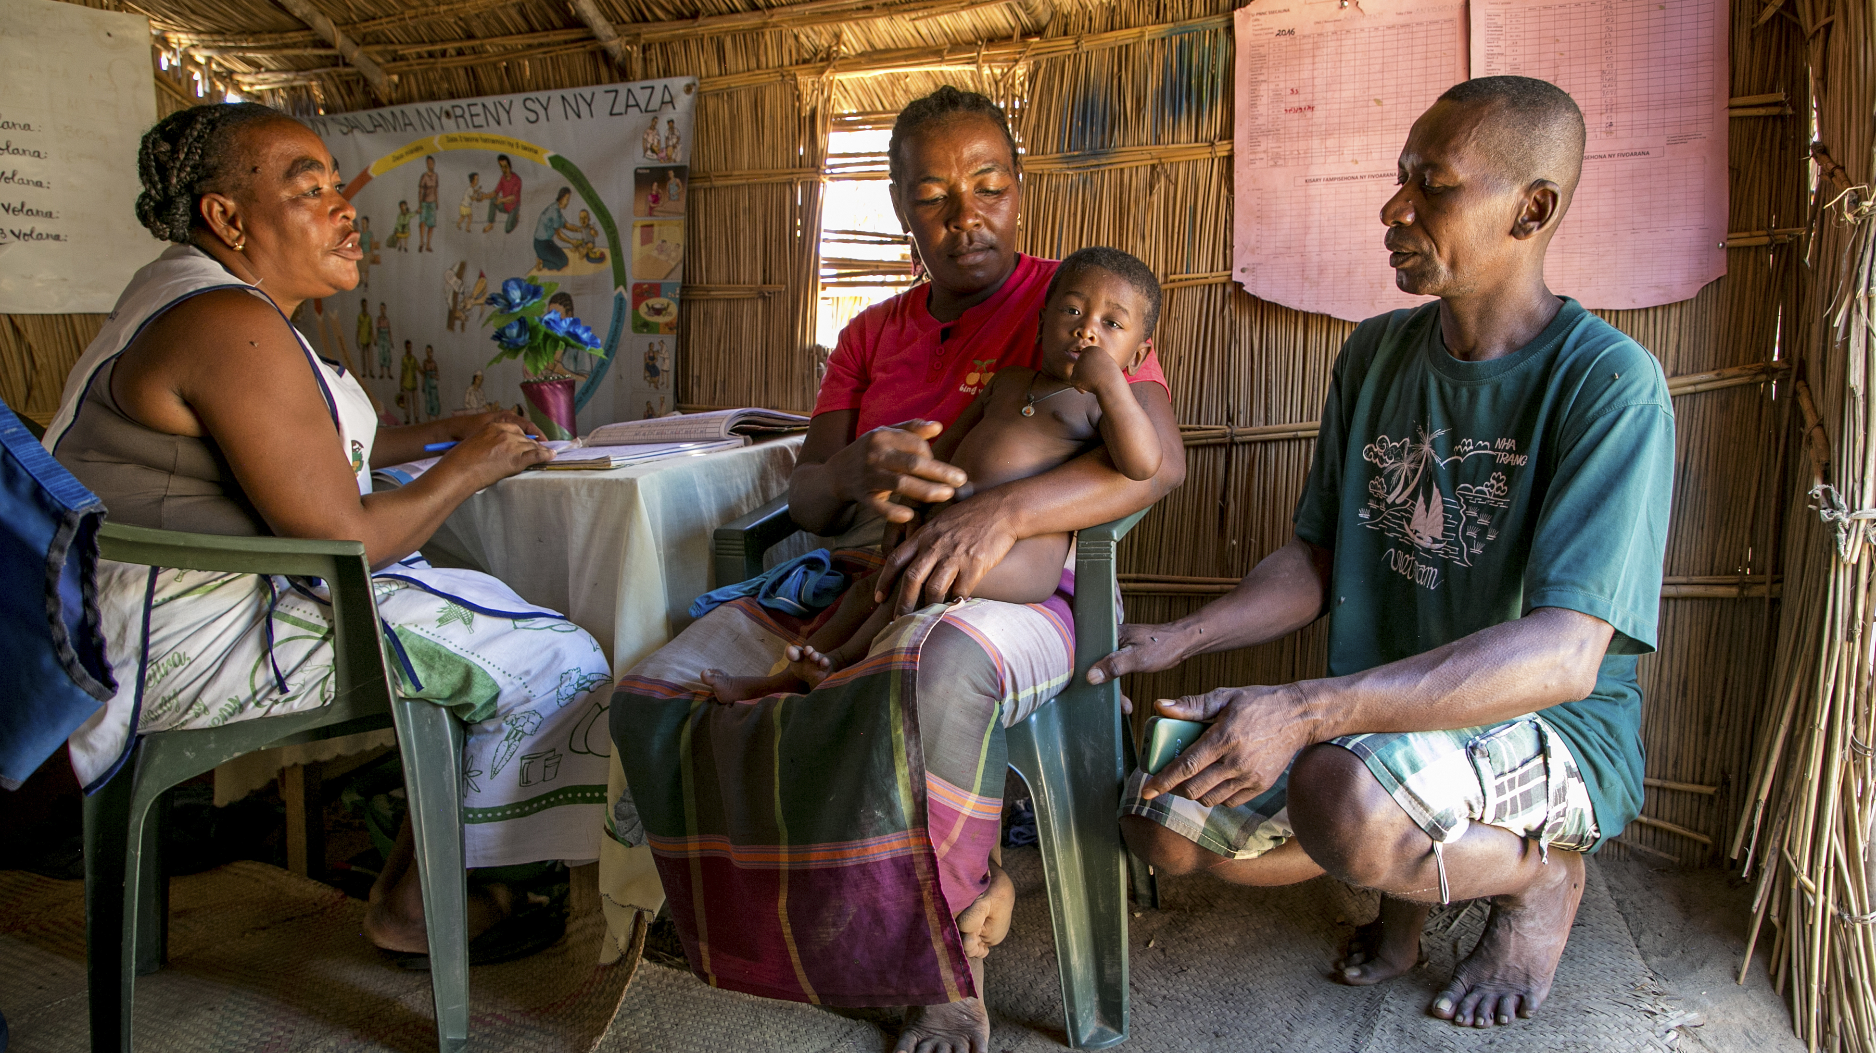
Visit the sick
Photo by Jim Stipe/CRS
Notes:
In a small health station in a rural community in southern Madagascar, a community health worker meets with Frankline and her husband Labaladezy as they bring in their 11-month-old Thorin for a health appointment. The health workers weigh Thorin and take an arm measurement to monitor his growth and nutrition levels.
In Madagascar, half of all children are undernourished. But through a CRS program called Community Led Total Nutrition, families are learning how doctor visits, hand washing and eating different foods with essential vitamins and nutrients can help them stay healthy. The program trains community health workers, who then work with families through innovative and creative approaches such as skits and puppet shows to teach them new ways to support their children’s health and growth. The health workers perform regular check-ups to detect early signs of malnutrition or other health concerns. In this approach, everyone in the community works together to ensure all children have access to better food and nutrition.

Slide 14
Visit the imprisoned
Notes:
This work of mercy is also known as “Ransom (or redeem) the captives.” The word redeem refers to the liberation of a weight, of a burden that overwhelms and imprisons. Christ the Redeemer came to free us from the weight of our own sins. All redemption is born of mercy.
A captive is any person who is deprived of his freedom. Many incarcerated people are paying debts through the justice system, while others have been deprived of their freedom without having committed any crime. Both are in captivity and may be suffering contempt and abuse. The captivity they suffer is not only physical, but also emotional because many times they are condemned even before receiving a sentence—by their own families, by society and, in many cases, by their own conscience. To be redeemed, the first step is for them to be recognized and accepted as persons.
God longs for us to seek out the captive in our midst, so all may know the freedom he wants for each of us. We are called to show compassion to our imprisoned sisters and brothers as they, like us, are made in the image and likeness of God.

Slide 15
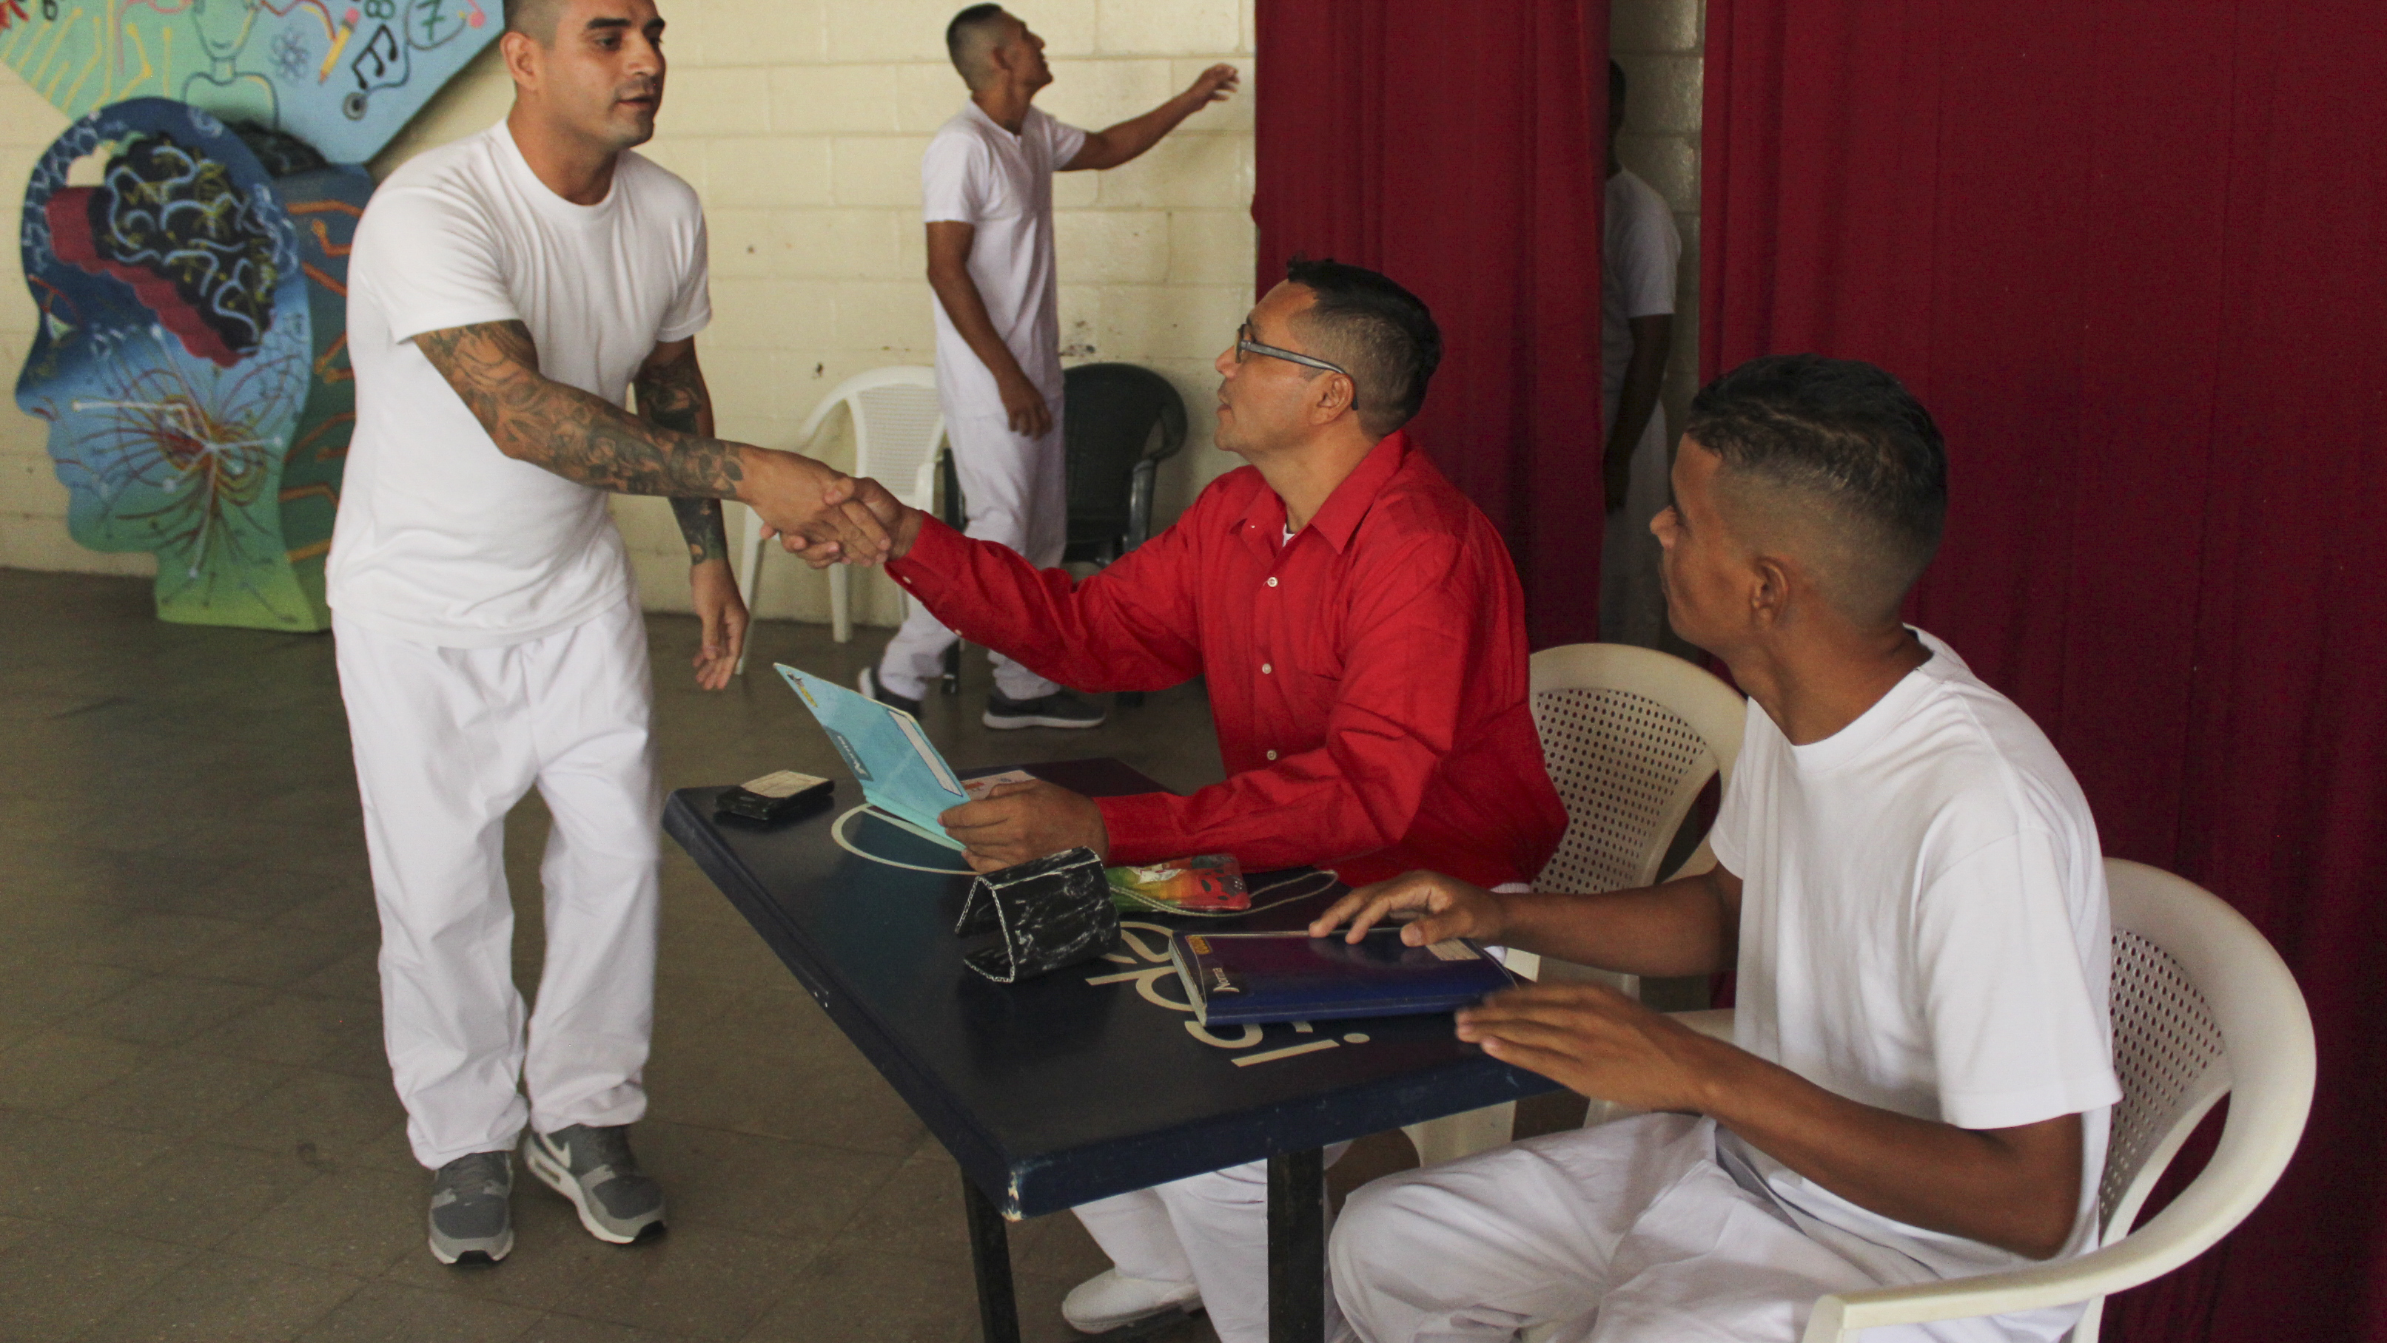
Visit the imprisoned
Photo by Oscar Leiva/Silverlight for CRS
Notes:
In El Salvador, prisoners at La Esperanza penitentiary can participate in CRS Second Chances, a rehabilitation and reintegration project. The program works with the Government of El Salvador´s penitentiary system to develop a rehabilitation curriculum to provide inmates with social skills to change negative behaviors, develop positive behaviors and prepare them to re-enter the workforce after being released from prison.

Slide 16
Bury the dead
Notes:
Burial with dignity honors the deceased, respecting and protecting the body that bore them through this world, while also protecting the community. As we care for the living, each of us being the image and likeness of God, we ultimately honor the dead with our prayers and respect, hoping that they may find a full and glorious reconciliation with their maker.

Slide 17
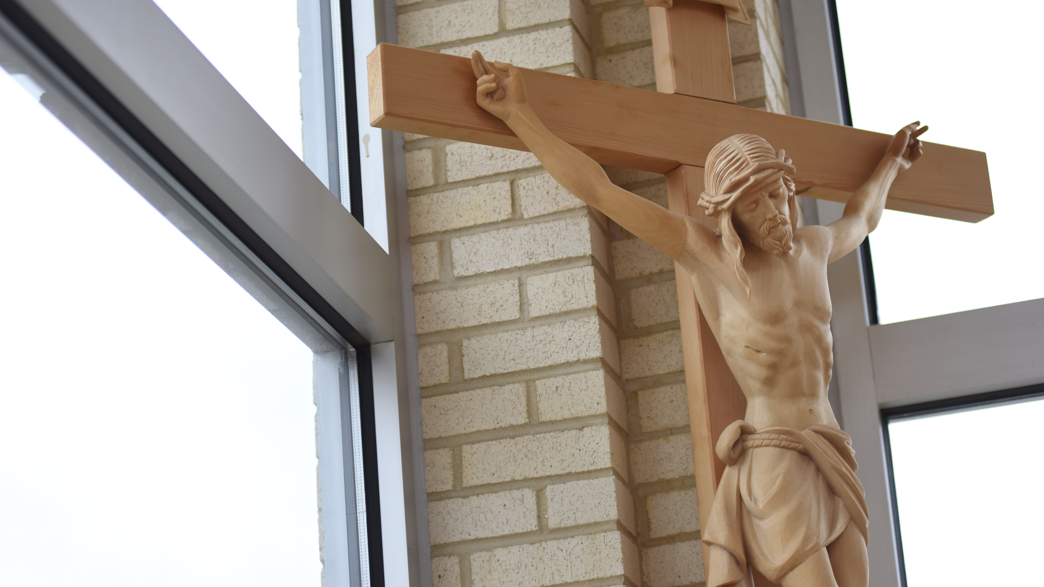
Bury the dead
Photo by Lauren Carroll/CRS
Notes:
During Holy Week, we prepare for the Passion and Crucifixion of our Lord. Joseph of Arimathea “courageously went to Pilate and asked for the body of Jesus” (Mark 15:43), and Nicodemus “came bringing a mixture of myrrh and aloes weighing about one hundred pounds” (John 19:39). They carefully wrapped Jesus’ body in fine linen along with the spices according to the Jewish burial custom and buried him in a newly hewn tomb (John 19:40-41).
Despite the danger of this action—burying a condemned criminal who had been publicly executed—Joseph of Arimathea and Nicodemus took care of Jesus’ body with reverence and love. When we show care and respect for the deceased, we carry out this important work of mercy.

Slide 18
Pope Francis and the Works of Mercy (videos)
Feed the hungry
Pope Francis has lunch with 1,500 people in need on World Day of Poor
Give drink to the thirsty
Pope Francis: "Water" the most essential element for life
Clothe the naked
Pope Francis opens a laundromat for the homeless
Shelter the homeless (Welcome the stranger)
Pope tells a refugee’s story

Slide 19
Pope Francis and the Works of Mercy (videos)
Visit the sick
Pope Francis visits the terminally ill in Paraguay
Visit the imprisoned
Pope Francis visits Philadelphia prison
Bury the dead
Pope Francis consoles a boy who asked if his non-believing father is in Heaven

